Slide 1


Data Structure
Course Code : ENCS205
Dr Swati Gupta
Associate Professor, School of Engineering & Technology
K.R. Mangalam University
Unit 4 :Trees and Graphs
Notes:
New Courses replaced with New Programmes

Slide 2

TOPOLOGICAL SORT
Session 54
Topological Sort
Application of Topological Sort
Algorithm of Topological Sort
Example of Topological Sort
Brainstorming Session
Notes:
New Courses replaced with New Programmes

Slide 3
RECAP
A graph is a non-linear data structure made up of nodes or vertices and edges.
Breadth-First Search (BFS) is a graph traversal algorithm, where we start from a selected(source) node and traverse the graph level by level, by exploring the neighbor nodes at each level.
Depth-First Search (DFS) is a graph traversal algorithm, which starts at the root node and examines each branch as far as possible before backtracking.
Notes:
New Courses replaced with New Programmes

Slide 4
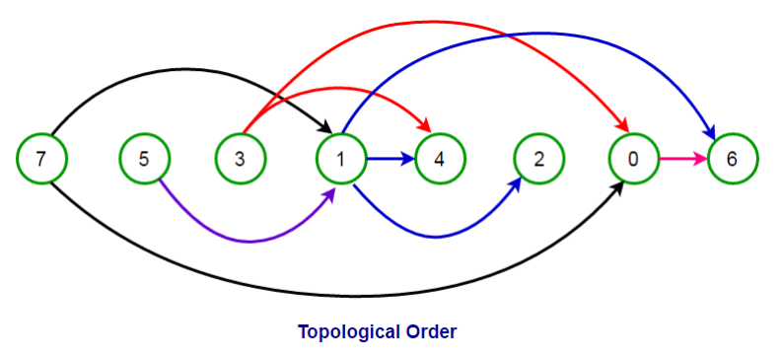
Topological sort
Topological sorting is a dependency problem in which completion of one task depends upon the completion of several other tasks whose order can vary.
Topological sorting for Directed Acyclic Graph is a linear ordering of vertices such that for every directed edge u->v, vertex u comes before v in the order.
The first vertex in topological sorting is always a vertex with an in-degree of zero.
Notes:
New Courses replaced with New Programmes

Slide 5
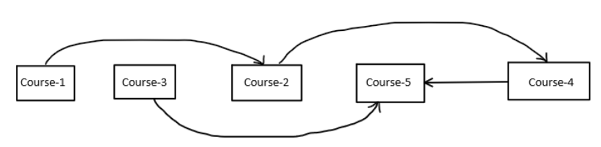
Applications of Topological sort
Used in Critical Path Analysis
Operation System deadlock detection
Course Schedule problem
Instruction Scheduling
Notes:
New Courses replaced with New Programmes

Slide 6
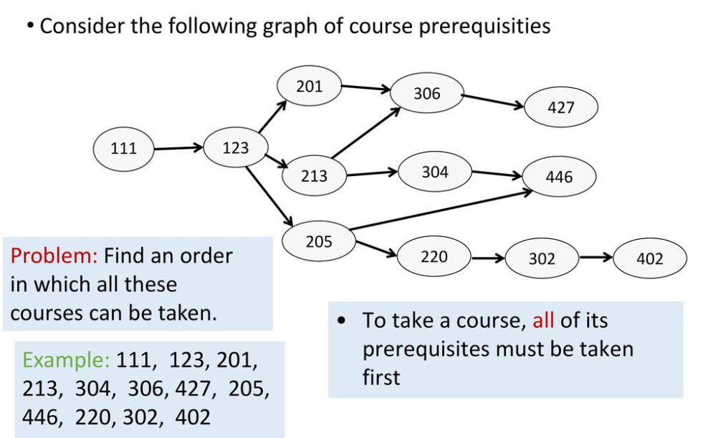
Topological sort
Notes:
New Courses replaced with New Programmes

Slide 7
Topological sort : Algorithm
TOPOLOGICAL-SORT(G):
call DFS(G) to compute finishing times f[v] for each vertex v
as each vertex is finished, insert it onto the front of a linked list
return the linked list of vertices
Note that the result is just a list of vertices in order of decreasing finish times f[]
Notes:
New Courses replaced with New Programmes

Slide 8
Topological Sort : Example
Call DFS(G) to compute the finishing times f[v]
Time = 1
Time = 2
d = ∞
f = ∞
Let’s say we start the DFS from the vertex c
a
d = ∞
f = ∞
Next we discover the vertex d
d = ∞
f = ∞
d = 1
f = ∞
b
c
c
d = ∞
f = ∞
d = ∞
f = ∞
d
e
d = ∞
f = ∞
f

Slide 9
Topological Sort : Example
Call DFS(G) to compute the finishing times f[v]
Time = 2
Time = 3
d = ∞
f = ∞
Let’s say we start the DFS from the vertex c
a
d = 1
f = ∞
Next we discover the vertex d
d = ∞
f = ∞
b
c
c
d = ∞
f = ∞
d = ∞
f = ∞
d = 2
f = ∞
d
d
e
d = ∞
f = ∞
f

Slide 10
Topological Sort : Example
Call DFS(G) to compute the finishing times f[v]
Time = 3
Time = 4
as each vertex is finished, insert it onto the front of a linked list
d = ∞
f = ∞
Let’s say we start the DFS from the vertex c
a
d = 1
f = ∞
Next we discover the vertex d
d = ∞
f = ∞
b
c
c
Next we discover the vertex f
d = 2
f = ∞
d = ∞
f = ∞
f is done, move back to d
d
d
e
d = 3
f = ∞
d = 3
f = 4
f
f
f

Slide 11
Topological Sort : Example
Call DFS(G) to compute the finishing times f[v]
Time = 4
Time = 5
d = ∞
f = ∞
Let’s say we start the DFS from the vertex c
a
d = 1
f = ∞
Next we discover the vertex d
d = ∞
f = ∞
b
c
c
Next we discover the vertex f
d = 2
f = 5
d = ∞
f = ∞
f is done, move back to d
d
d
e
d is done, move back to c
d = 3
f = 4
f
f
d
f

Slide 12
Topological Sort : Example
Call DFS(G) to compute the finishing times f[v]
Time = 5
Time = 6
d = ∞
f = ∞
Let’s say we start the DFS from the vertex c
a
d = 1
f = ∞
Next we discover the vertex d
d = ∞
f = ∞
b
c
c
Next we discover the vertex f
d = 2
f = 5
d = ∞
f = ∞
f is done, move back to d
d
d
e
d is done, move back to c
d = 3
f = 4
f
Next we discover the vertex e
f
d
f

Slide 13
Topological Sort : Example
Call DFS(G) to compute the finishing times f[v]
Time = 6
Time = 7
d = ∞
f = ∞
Let’s say we start the DFS from the vertex c
a
d = 1
f = ∞
Next we discover the vertex d
d = ∞
f = ∞
b
c
Next we discover the vertex f
Both edges from e are cross edges
d = 2
f = 5
d = 6
f = ∞
f is done, move back to d
d
d
e
e
d is done, move back to c
d = 3
f = 4
f
Next we discover the vertex e
f
e is done, move back to c
e
d
f

Slide 14
Topological Sort : Example
Call DFS(G) to compute the finishing times f[v]
Time = 7
Time = 8
d = ∞
f = ∞
Let’s say we start the DFS from the vertex c
a
d = 1
f = ∞
Next we discover the vertex d
d = ∞
f = ∞
b
c
Next we discover the vertex f
d = 2
f = 5
d = 6
f = 7
f is done, move back to d
d
d
e
e
d is done, move back to c
d = 3
f = 4
f
Next we discover the vertex e
f
e is done, move back to c
c
e
d
f
c is done as well

Slide 15
Topological Sort : Example
Call DFS(G) to compute the finishing times f[v]
Time = 9
Time = 10
d = ∞
f = ∞
Let’s now call DFS visit from the vertex a
d = 9
f = ∞
a
a
d = 1
f = 8
Next we discover the vertex c,
but c was already processed => (a,c) is a cross edge
d = ∞
f = ∞
b
c
d = 2
f = 5
d = 6
f = 7
Next we discover the vertex b
d
d
e
e
d = 3
f = 4
f
f
c
e
d
f

Slide 16
Topological Sort : Example
Call DFS(G) to compute the finishing times f[v]
Time = 10
Time = 11
d = 9
f = ∞
Let’s now call DFS visit from the vertex a
a
a
d = 1
f = 8
Next we discover the vertex c,
but c was already processed => (a,c) is a cross edge
d = 10
f = ∞
d = 10
f = 11
b
b
c
d = 2
f = 5
d = 6
f = 7
Next we discover the vertex b
d
d
e
e
d = 3
f = 4
f
f
b
c
e
d
f

Slide 17
Topological Sort : Example
Call DFS(G) to compute the finishing times f[v]
Time = 11
Time = 12
d = 9
f = ∞
Let’s now call DFS visit from the vertex a
a
a
d = 1
f = 8
Next we discover the vertex c,
but c was already processed => (a,c) is a cross edge
d = 10
f = 11
b
b
c
d = 2
f = 5
d = 6
f = 7
Next we discover the vertex b
d
d
e
e
b is done as (b,d) is a cross edge => now move back to c
d = 3
f = 4
f
f
a is done as well
b
c
e
d
f

Slide 18
Topological Sort : Example
Call DFS(G) to compute the finishing times f[v]
Time = 11
Time = 13
d = 9
f = 12
Let’s now call DFS visit from the vertex a
WE HAVE THE RESULT!
return the linked list of vertices
a
a
d = 1
f = 8
Next we discover the vertex c,
but c was already processed => (a,c) is a cross edge
d = 10
f = 11
b
b
c
d = 2
f = 5
d = 6
f = 7
Next we discover the vertex b
d
d
e
e
b is done as (b,d) is a cross edge => now move back to c
d = 3
f = 4
f
f
a is done as well
a
b
c
e
d
f

Slide 19
Topological Sort : Example
Time = 11
Time = 13
The linked list is sorted in decreasing order of finishing times f[]
d = 9
f = 12
a
a
d = 10
f = 11
d = 1
f = 8
b
Try yourself with different vertex order for DFS visit
b
c
d = 2
f = 5
d = 6
f = 7
d
d
e
e
d = 3
f = 4
f
f
a
b
c
e
d
f

Slide 20
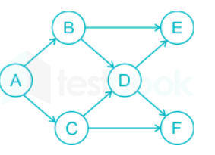
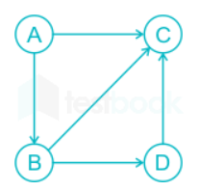
Test Your Knowledge
1 How many topological ordering for the given graph G exist
2
3
4
5
Answer (C)
2 Which of the following is valid topological ordering for the given graph G
ABCD
BACD
BADC
ABDC
Notes:
New Courses replaced with New Programmes

Slide 21
Test Your Knowledge
3. Which of the following is not an application of topological sorting?
a) Finding prerequisite of a task b) Finding Deadlock in an Operating System c) Finding Cycle in a graph d) Ordered Statistics
Answer (D)
4. Topological sort of a Directed Acyclic graph is? a) Always unique b) Always Not unique c) Sometimes unique and sometimes not unique d) Always unique if graph has even number of vertices
Answer (C)
Notes:
New Courses replaced with New Programmes

Slide 22
REVIEW
A graph is a non-linear data structure made up of nodes or vertices and edges.
Breadth-First Search (BFS) is a graph traversal algorithm, where we start from a selected(source) node and traverse the graph level by level, by exploring the neighbor nodes at each level.
Depth-First Search (DFS) is a graph traversal algorithm, which starts at the root node and examines each branch as far as possible before backtracking.
Notes:
New Courses replaced with New Programmes

Slide 23

References
https://www.boardinfinity.com/blog/graphs-in-data-structure/.
https://www.geeksforgeeks.org/what-is-graph-data-structure/
https://www.tutorialspoint.com/data_structures_algorithms/graph_data_structure.html.
https://www.simplilearn.com/tutorials/data-structure-tutorial/graphs-in-data-structure
https://www.geeksforgeeks.org/applications-of-graph-data-structure/
https://www.upgrad.com/blog/graphs-in-data-structure/
https://www.youtube.com/watch?v=4IZ80K72OXo
Notes:
New Courses replaced with New Programmes

Slide 24
THANK YOU

